Slide 1
Unit 5-Control Unit and
Input / Output Organization
Control unit operation: Micro-operations, Control of the processor, Hardwired implementation, Micro- programmed Control Unit, Basic concepts, Micro-instruction sequencing, Micro-instruction execution, Applications of micro-programming.
Input/output Organization: External devices, I/O module, Programmed I/O, Interrupt driven I/O, Direct memory access, I/O channels and processors, External interface. Instruction pipe-lining: Concepts. Parallel processing: Multiple processor organization, Symmetric multiprocessor, Cache coherence and the MESI protocol.

Slide 2
Micro-Operations
A computer executes a program.
Fetch/execute cycle.
Each instruction cycle is made up of a number of smaller units.
One subdivision that we found convenient is fetch, indirect, execute, and interrupt, with only fetch and execute cycles always occurring.
Sub parts of fetch, indirect, execute, and interrupt are Called as micro-operations
Each step does very little.
Atomic operation of CPU.

Slide 3
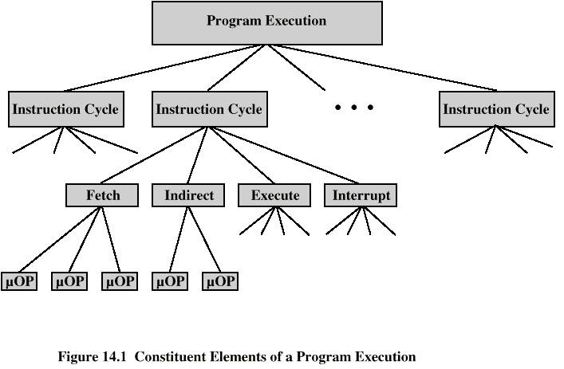
Constituent Elements of
Program Execution

Slide 4
Fetch - 4 Registers
Memory Address Register (MAR)
  Connected to address bus
  Specifies address for read or write op
Memory Buffer Register (MBR)
  Connected to data bus
  Holds data to write or last data read
Program Counter (PC)
  Holds address of next instruction to be fetched
Instruction Register (IR)
  Holds last instruction fetched

Slide 5
Fetch Sequence
Address of next instruction is in PC
Address (MAR) is placed on address bus
Control unit issues READ command
Result (data from memory) appears on data bus
Data from data bus copied into MBR
PC incremented by 1 (in parallel with data fetch from memory)
Data (instruction) moved from MBR to IR
MBR is now free for further data fetches

Slide 6

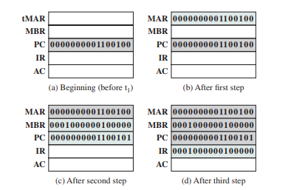
Fetch Sequence

Slide 7
Rules for Clock Cycle Grouping
Proper sequence must be followed
  MAR <- (PC) must precede MBR <- (memory)
Conflicts must be avoided
  Must not read & write same register at same time
  MBR <- (memory) & IR <- (MBR) must not be in same cycle
Also: PC <- (PC) +1 involves addition
  Use ALU
  May need additional micro-operations

Slide 8
Indirect Cycle
MAR <- (IR_{address}) - address field of IR
MBR <- (memory)
IR_{address} <- (MBR_{address})
MBR contains an address
IR is now in same state as if direct addressing had been used
(What does this say about IR size?)

Slide 9
Interrupt Cycle
t1: MBR <-(PC)
t2: MAR <- save-address
PC <- routine-address
t3: memory <- (MBR)
This is a minimum
  May be additional micro-ops to get addresses
  N.B. saving context is done by interrupt handler routine, not micro-ops

Slide 10
Execute Cycle (ADD)
Different for each instruction
e.g. ADD R1,X - add the contents of location X to Register 1 , result in R1
t1: MAR <- (IR_{address})
t2: MBR <- (memory)
t3: R1 <- R1 + (MBR)
Note no overlap of micro-operations

Slide 11
Execute Cycle (ISZ)
ISZ X - increment and skip if zero
  t1: MAR <- (IR_{address})
  t2: MBR <- (memory)
  t3: MBR <- (MBR) + 1
  t4: memory <- (MBR)
  if (MBR) == 0 then PC <- (PC) + 1
Notes:
  if is a single micro-operation
  Micro-operations done during t4

Slide 12
Instruction Cycle
Each phase decomposed into sequence of elementary micro-operations
E.g. fetch, indirect, and interrupt cycles
Execute cycle
  One sequence of micro-operations for each opcode
Need to tie sequences together
Assume new 2-bit register
  Instruction cycle code (ICC) designates which part of cycle processor is in
    00: Fetch
    01: Indirect
    10: Execute
    11: Interrupt

Slide 13
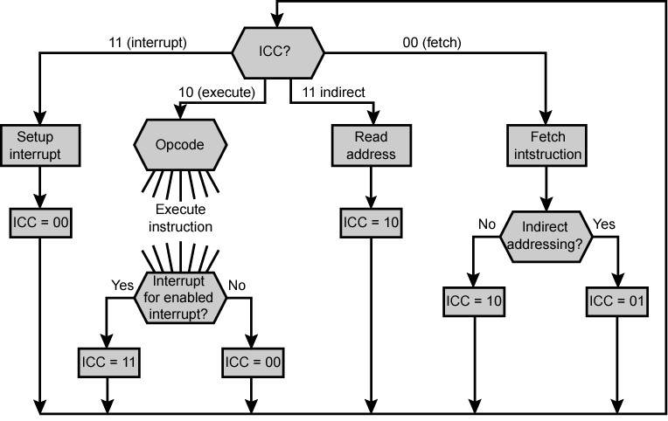
Flowchart for Instruction Cycle

Slide 14
Functional Requirements
Define basic elements of processor
Describe micro-operations processor performs
Determine functions control unit must perform

Slide 15
Basic Elements of Processor
ALU
Registers
Internal data pahs
External data paths
Control Unit

Slide 16
Types of Micro-operation
Transfer data between registers
Transfer data from register to external
Transfer data from external to register
Perform arithmetic or logical ops

Slide 17
Functions of Control Unit
Sequencing
  Causing the CPU to step through a series of micro-operations
Execution
  Causing the performance of each micro-op
This is done using Control Signals

Slide 18
Control Signals
Clock
  One micro-instruction (or set of parallel micro-instructions) per clock cycle
Instruction register
  Op-code for current instruction
  Determines which micro-instructions are performed
Flags
  State of CPU
  Results of previous operations
From control bus
  Interrupts
  Acknowledgements

Slide 19
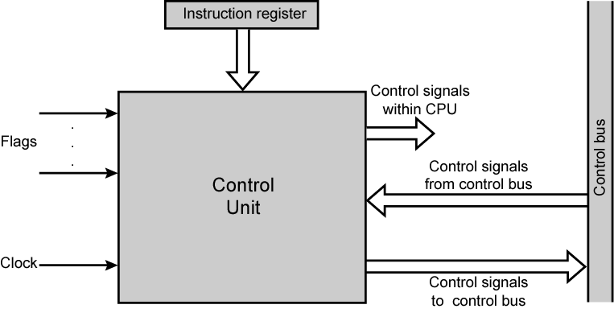
Model of Control Unit

Slide 20
Control Signals - output
Within CPU(2 Types)
  Cause data movement(Register-Register-ALU)
  Activate specific functions(ALU)
Via control bus(2 Types)
  To memory
  To I/O modules

Slide 21
Example Control Signal Sequence - Fetch
MAR <- (PC)
  Control unit activates signal to open gates between PC and MAR
MBR <- (memory)
  Open gates between MAR and address bus
  Memory read control signal
  Open gates between data bus and MBR

Slide 22
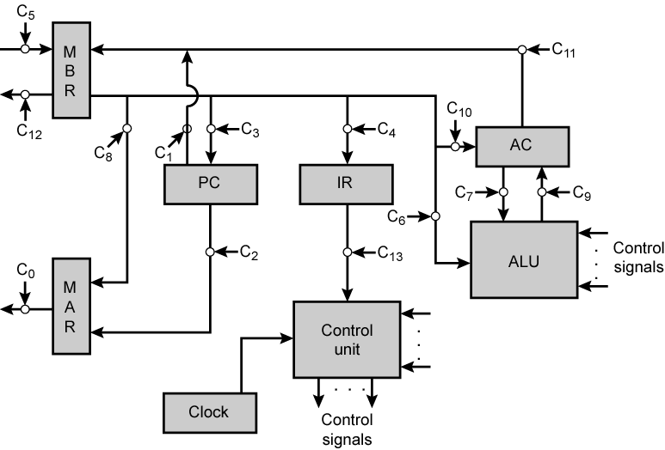
Data Paths and Control Signals

Slide 23
Internal Organization
Usually a single internal bus
Gates control movement of data onto and off the bus
Control signals control data transfer to and from external systems bus
Temporary registers needed for proper operation of ALU

Slide 24
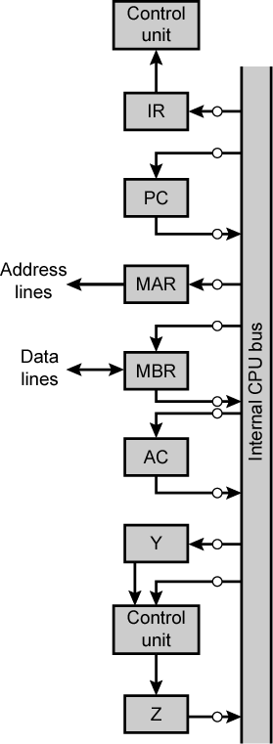
CPU with
Internal
Bus

Slide 25
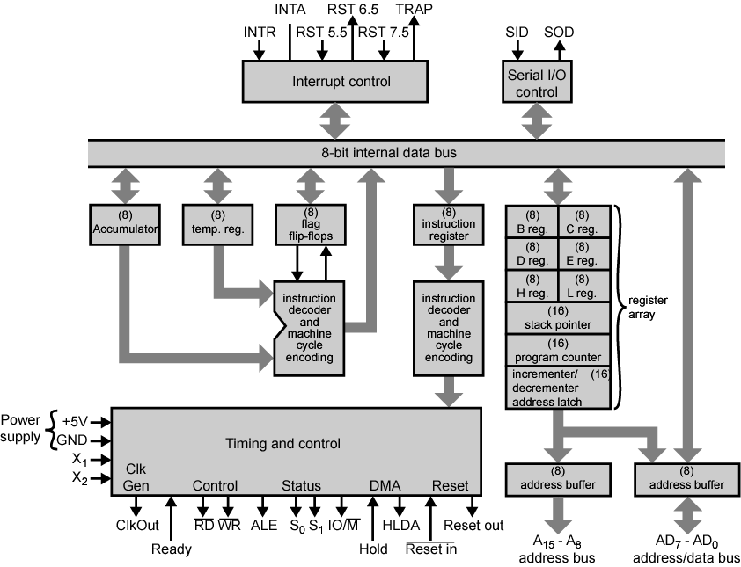
Intel 8085 CPU Block Diagram

Slide 26
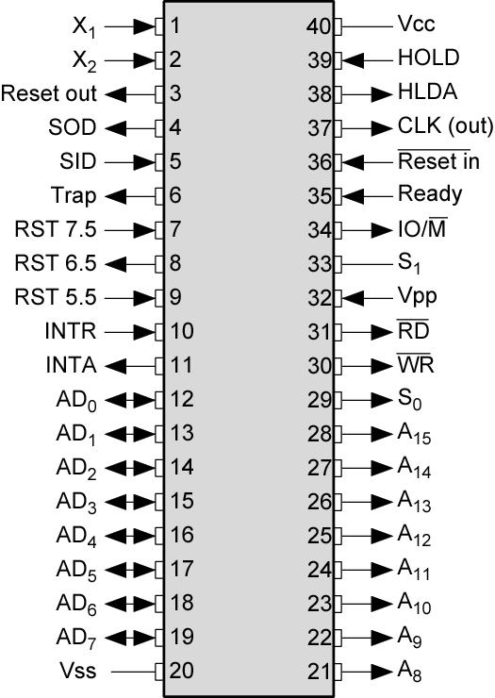
Intel 8085 Pin
Configuration

Slide 27
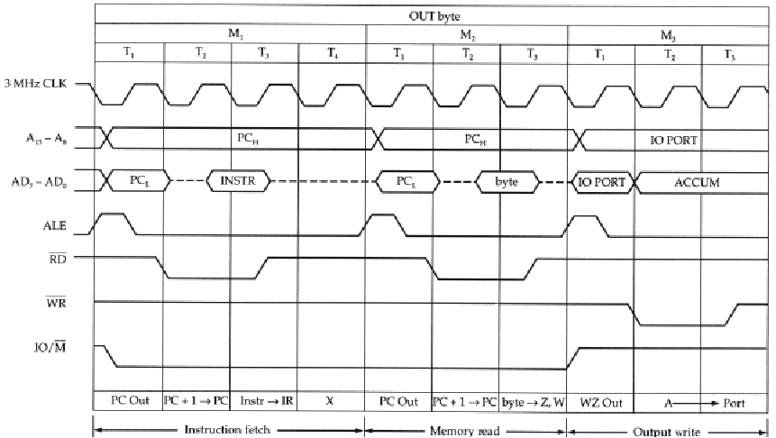
Intel 8085 OUT Instruction
Timing Diagram

Slide 28
Design of Control Unit:
Hardwired Implementation (1)
Control unit inputs
Flags and control bus
  Each bit means something
Instruction register
  Op-code causes different control signals for each different instruction
  Unique logic for each op-code
  Decoder takes encoded input and produces single output
  n binary inputs and 2^{n} outputs

Slide 29
Hardwired Implementation (2)
Clock
  Repetitive sequence of pulses
  Useful for measuring duration of micro-ops
  Must be long enough to allow signal propagation
  Different control signals at different times within instruction cycle
  Need a counter with different control signals for t1, t2 etc.

Slide 30
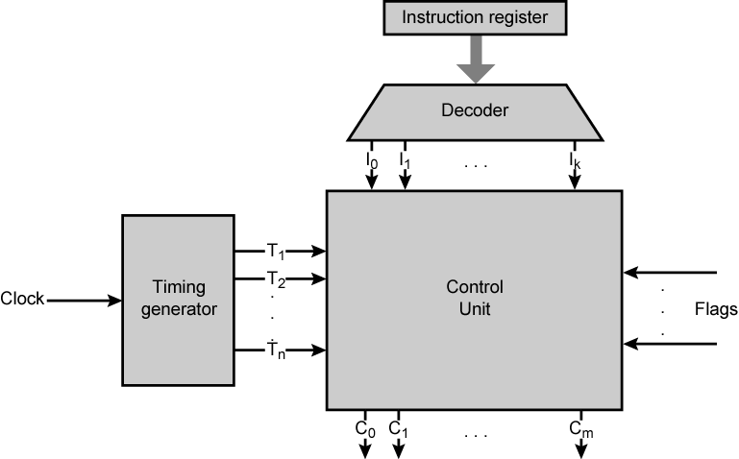
Control Unit with Decoded Inputs

Slide 31
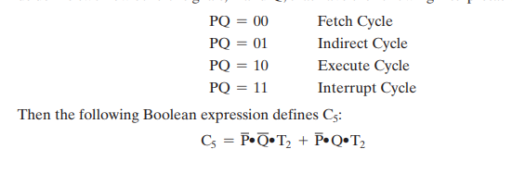
Problems With Hard Wired Designs
Complex sequencing & micro-operation logic
Difficult to design and test
Inflexible design
Difficult to add new instructions

Slide 32
Table of Contents I
Basic Concepts Microinstructions
Microprogrammed Control Unit
Advantages and Disadvantages
µ-Instruction sequencing
Two address fields
Variable Format
µ-Instruction Execution
Luis Tarrataca
<number> / 47

Slide 33
Remember what we talked about in the last class?
µ-operations - the most basic instruction executed by a processor:
Control signals - to send data from the various locations;
Control unit operation - how to control signals and micro-operations.
Luis Tarrataca

Slide 34
We saw that it was possible to operate the control unit through:
An hardwired version:
  Complete boolean circuit;
  Difficult to implement for complex systems.
  Impossible to add an instruction after implementing the circuit.
So what is the alternative? Any ideas?
Luis Tarrataca

Slide 35
Alternative: µ-programmed control unit
M
The logic of the control unit is specified by a microprogram;
  Also known as firmware.
A microprogram consists of a sequence of µ-operations.
Luis Tarrataca
<number> / 47

Slide 36
Microinstructions
How can we use the concept of microprogramming to implement a control unit?
For each µ-operation:
Control unit is allowed to generate a set of control signals;
Each control line is either on / off;
This state can be represented by a binary digit for each control line.
Luis Tarrataca

Slide 37
B
Idea: construct a control word (e.g. µ-instruction)
Bit represents one control line
Each µ-op would be represented by a different pattern of 1s and 0s.
Luis Tarrataca

Slide 38
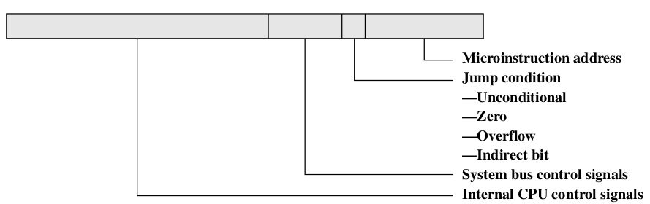
Format of the µ-instruction or control word is as follows:
Luis Tarrataca
<number> / 47
Figure: Microinstruction
One bit for each internal processor control line;
One bit for each system bus control line;
Condition field indicating the condition under which there should be a branch (JMP);
Field with the address of the µ-instruction to be executed next when a branch is taken.

Slide 39
Such a microinstruction is interpreted as follows:
Activate control lines indicated by a 1 bit;
Deactivate control lines indicated by a 0 bit;
If condition indicated by the condition bits is
  False: execute the next microinstruction in sequence;
  True: execute the instruction indicated in the address field.
Luis Tarrataca
<number> / 47

Slide 40
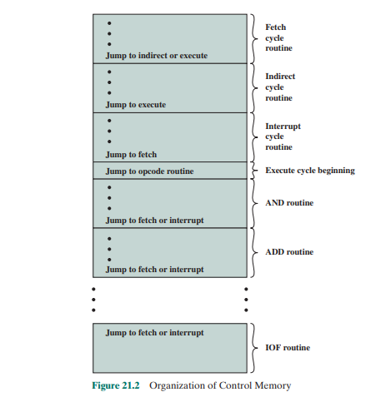
Luis Tarrataca
<number> / 47

Slide 41
Microprogrammed Control Unit
How can we process these µ-instructions?
Processing a µ-program requires:
Going through a sequence of µ-instructions;
Jumping to other addresses of µ-instructions;
I.e. normal procedure for processing instructions:
  Only difference is that these instructions are comprised of µ-operations.
Luis Tarrataca
<number> / 47

Slide 42
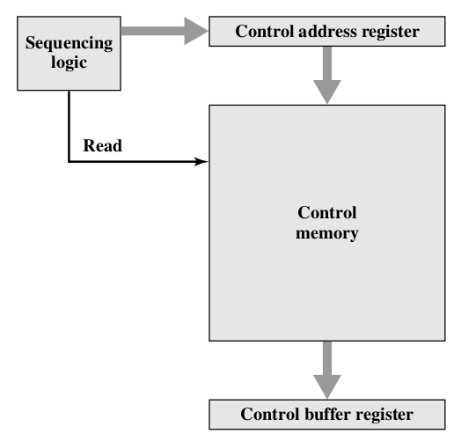
Lets take a look at one possible architecture:
Luis Tarrataca
<number> / 47
Figure: Control Unit Microarchitecture

Slide 43
Control memory:
  Containing the set of µ-instructions;
Control address register (CAR):
  Containing the address of the next µ-instruction to be read;
  Remember MAR?
Control buffer register (CBR):
  Containing the µ-instruction read from the control memory;
  After µ-instruction is read it can be executed;
  Remember MBR?
Sequencing logic:
  Loads CAR and issues a read command.
Luis Tarrataca
<number> / 47

Slide 44
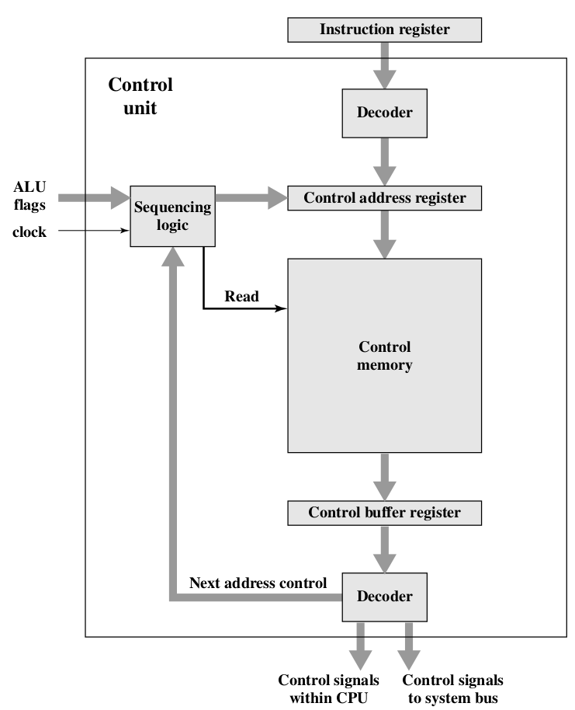
In greater detail:
Luis Tarrataca
<number> / 47
Figure: Function of microprogrammed control unit

Slide 45
The control unit functions as follows to execute an instruction:
1 Sequencing logic unit:
Loads an address to be read into CAR;
Issues a READ command to the control memory;
2 Word is read into CBR;
3 Content of the CBR generates:
Control signals for the CPU;
Next address for the sequencing logic unit;
4 Sequencing logic unit:
Loads a new address into the CAR;
Based on the next-address information from the CBR and the ALU flags.
All this happens during one clock pulse.
Luis Tarrataca
<number> / 47

Slide 46
Does all of this sound strangely familiar? Sense of de´ja` vu?
Similar to how control unit processed different stages of an instruction.
Remember?
Luis Tarrataca
<number> / 47
MAR
MBR
PC
Fetch cycle
Indirect cycle
Interrupt cycle
But now are doing it in a ‘‘smaller’’ scale within the control unit:
  Instead of a system-wide: processor, bus, ram...

Slide 47
Advantages and Disadvantages
Main advantage of the use of µ-programming:
Simplifies the design of the control unit;
  Both cheaper and less error prone to implement.
Hardwired control unit must contain complex logic:
  Microprogrammed control unit components are simple pieces of logic.
Main disadvantage of a µ-programmed unit:
Slower than a hardwired unit of comparable technology;
Luis Tarrataca
<number> / 47

Slide 48
µ-Instruction sequencing
Tasks performed by a microprogrammed control unit are:
µ-instruction sequencing:
  Get next µ-instruction from the control memory.
µ-instruction execution:
  Generate control signals needed to execute the µ-instruction.
Lets focus on the first one.
Luis Tarrataca
<number> / 47

Slide 49
Address of next µ-instruction to be executed is:
Determined by instruction register or;
Next sequential address or;
Branch (JMP). Decision is based on:
Current µ-instruction;
Condition flags;
Contents of the instruction register;
Luis Tarrataca
<number> / 47

Slide 50
Wide variety of techniques to generate the next µ-instruction address:
Two address fields
Single address field
Variable format
Luis Tarrataca
<number> / 47

Slide 51

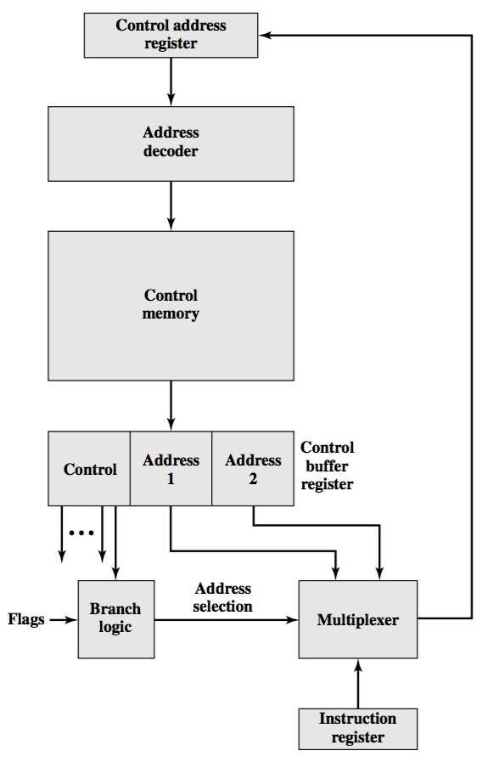
Two address fields
Luis Tarrataca
<number> / 47
Figure: Branch Control Logic: Two Address Fields

Slide 52
Simplest approach: provide two address fields:
Multiplex between both address fields and IR:
  Updating CAR accordingly.
CAR is decoded to produce the next µ-instruction address;
Branch logic module selects the address-selection signals:
  Based on control unit flags and
  Bits from the control portion of the µ-instruction.
Luis Tarrataca
<number> / 47

Slide 53
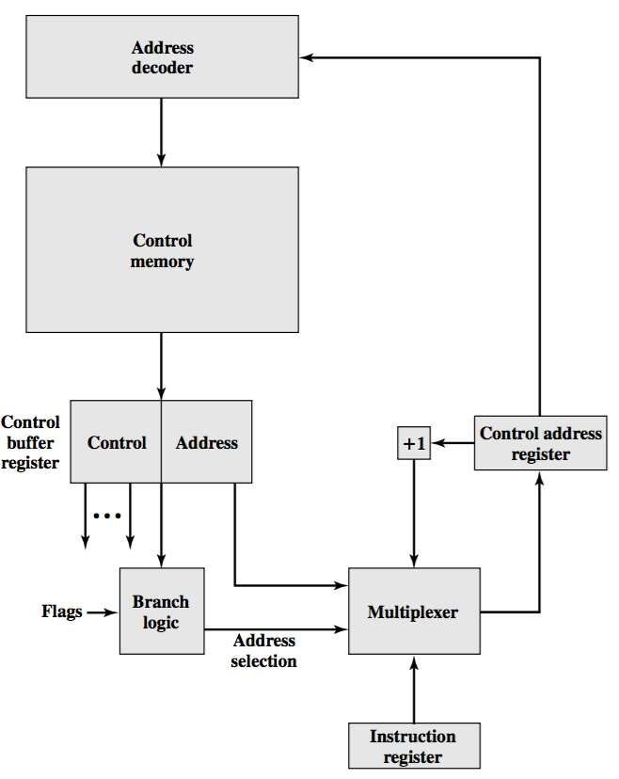
Single address field
<number> / 47

Slide 54
Two-address approach is simple but:
Requires more bits in the µ-instruction than other approaches.
Idea: Use additional logic to have only one address field; Options for next address are as follows:
Address field;
IR code;
Next sequential address (+1).
Luis Tarrataca
<number> / 47

Slide 55
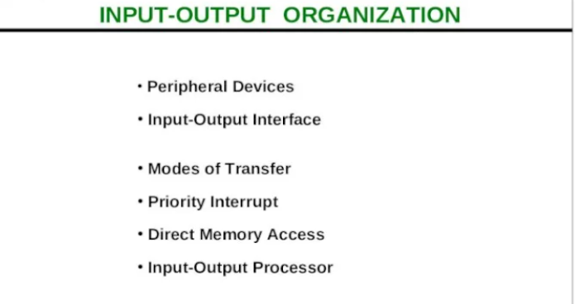
Luis Tarrataca

Slide 56
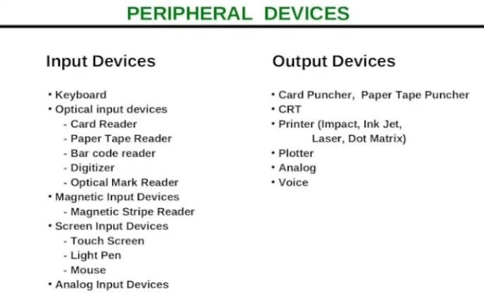
Luis Tarrataca

Slide 57
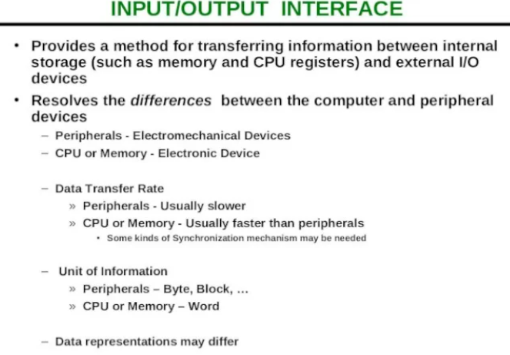
Luis Tarrataca

Slide 58
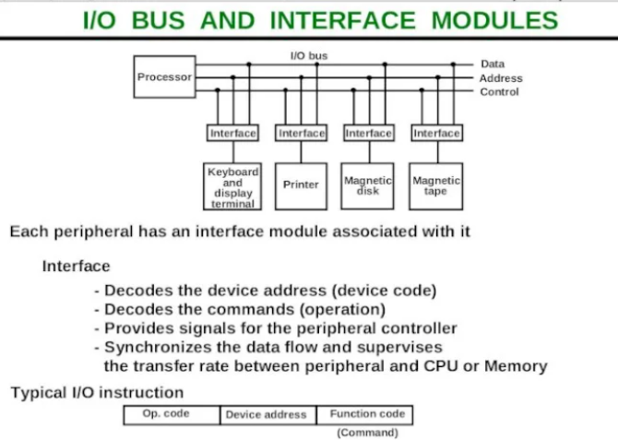
Luis Tarrataca

Slide 59
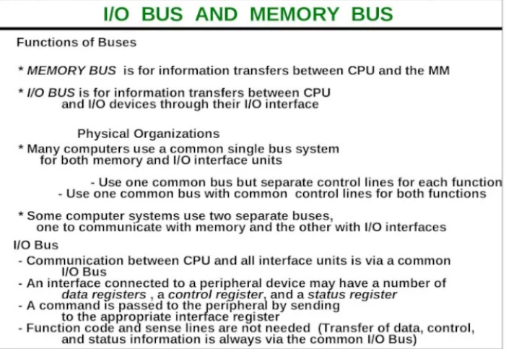
Luis Tarrataca

Slide 60
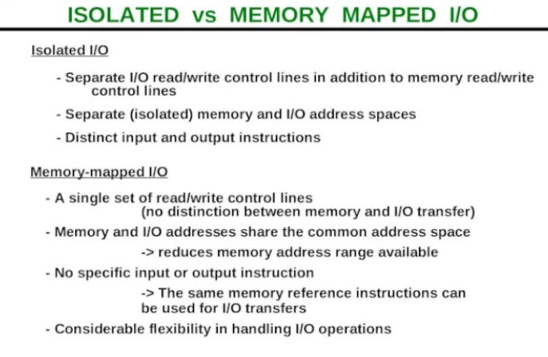
Luis Tarrataca

Slide 61
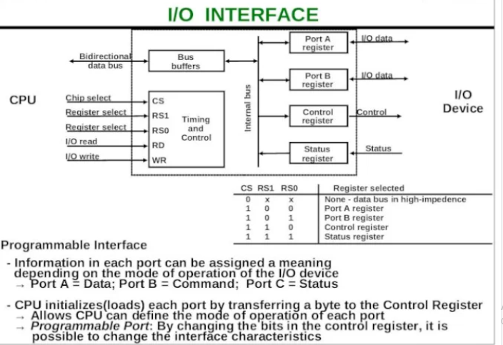
Luis Tarrataca

Slide 62
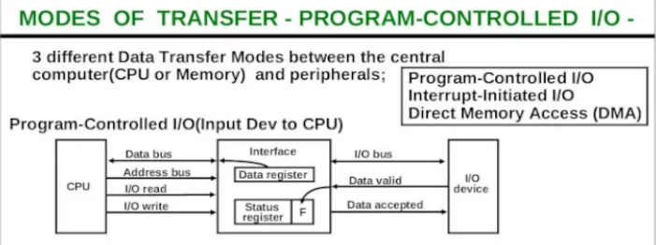
Luis Tarrataca

Slide 63
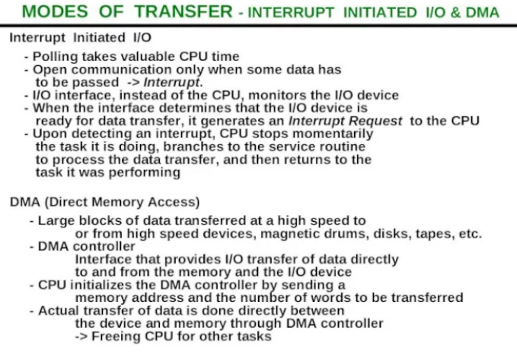
Luis Tarrataca

Slide 64
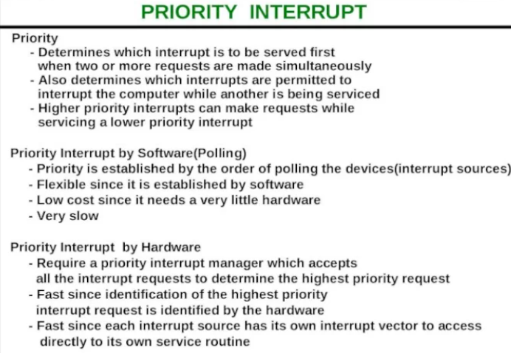
Luis Tarrataca

Slide 65
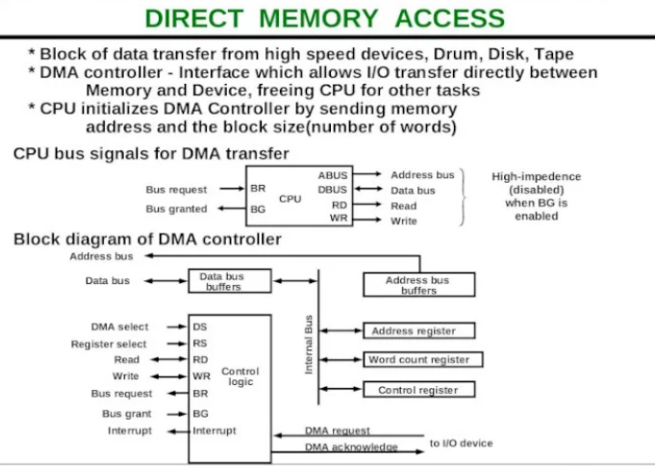
Luis Tarrataca

Slide 66
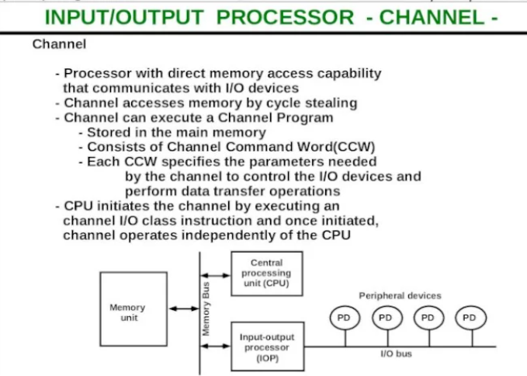
Luis Tarrataca

Slide 67
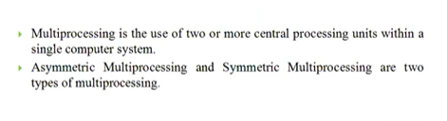
Luis Tarrataca

Slide 68
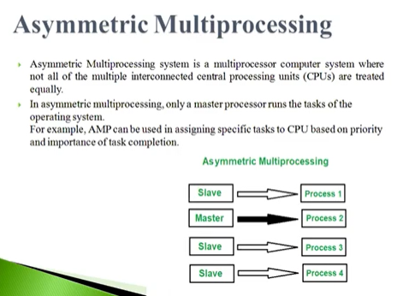
Luis Tarrataca

Slide 69
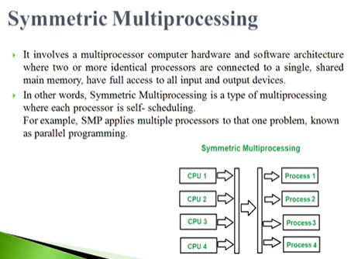
Luis Tarrataca

Slide 70
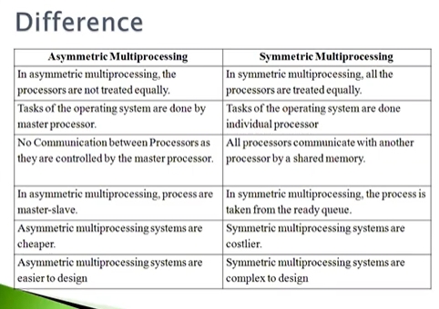
Luis Tarrataca

